Slide 1
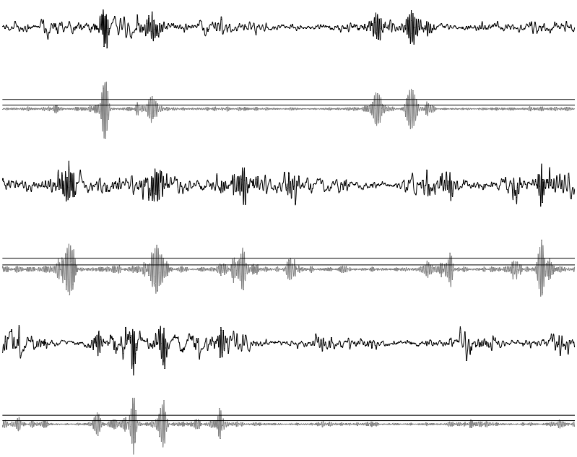
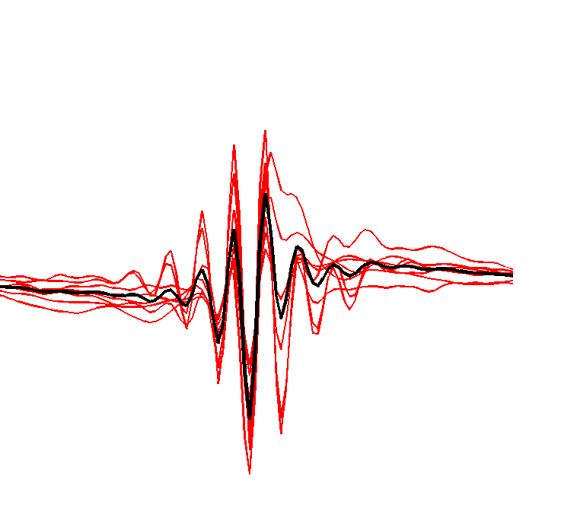
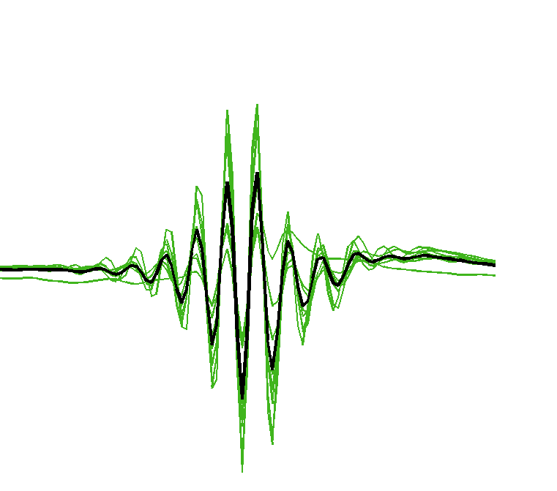
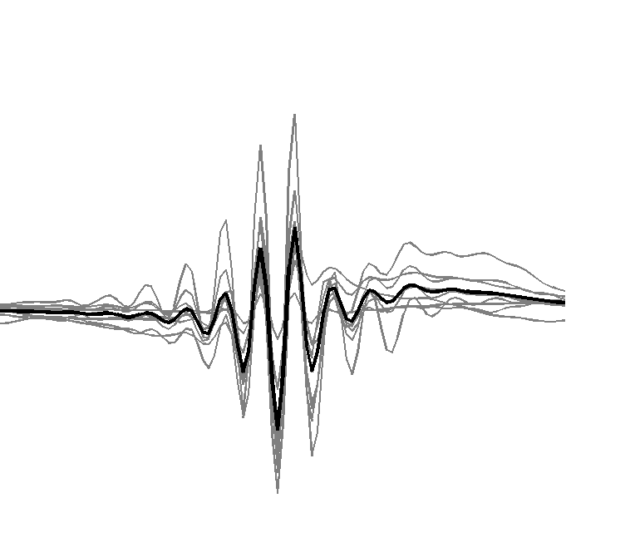
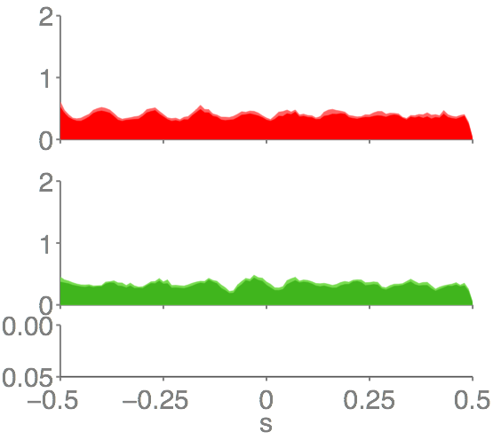
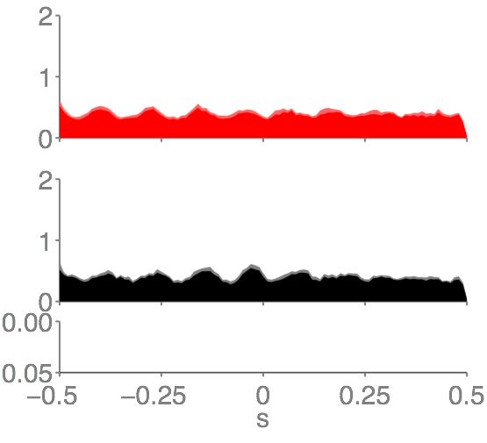
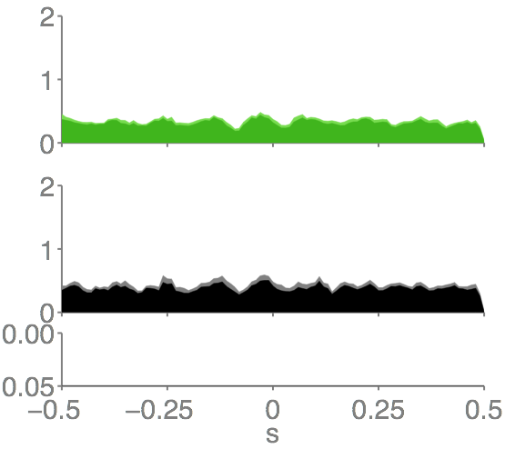
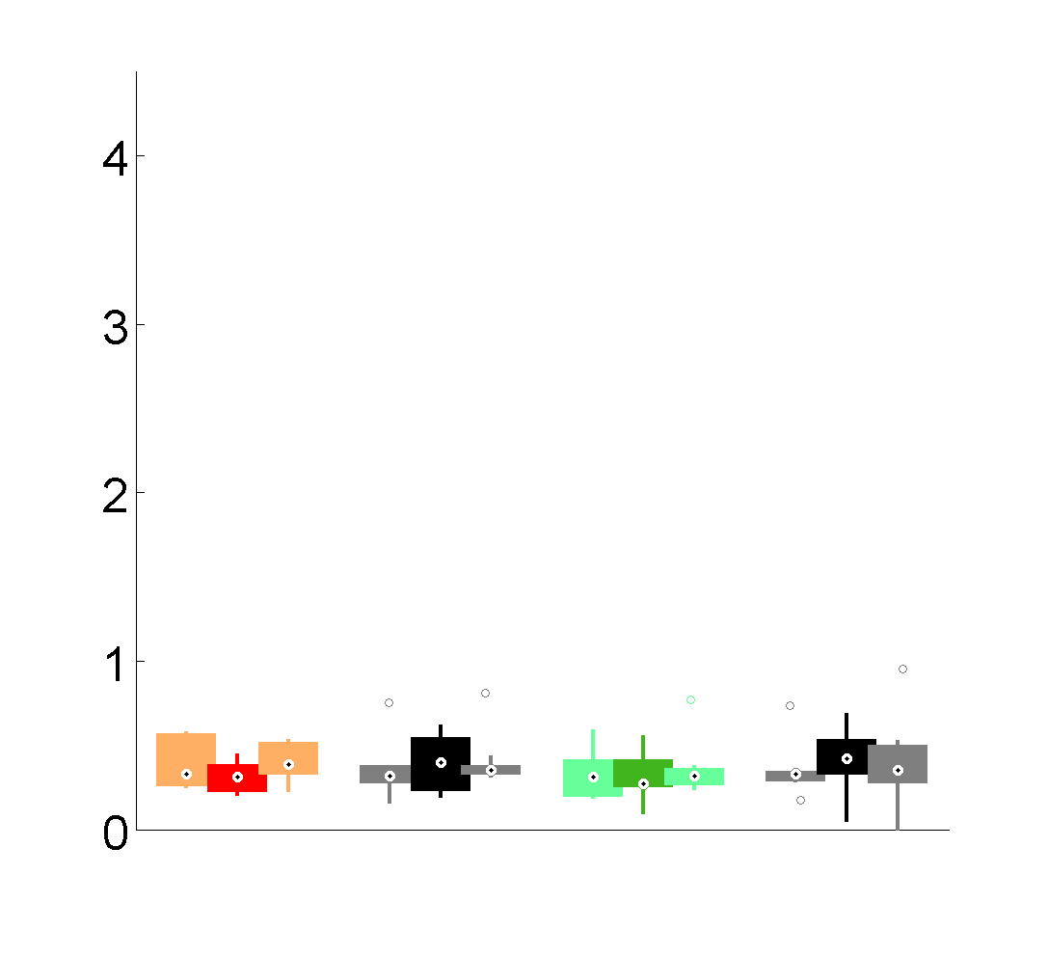
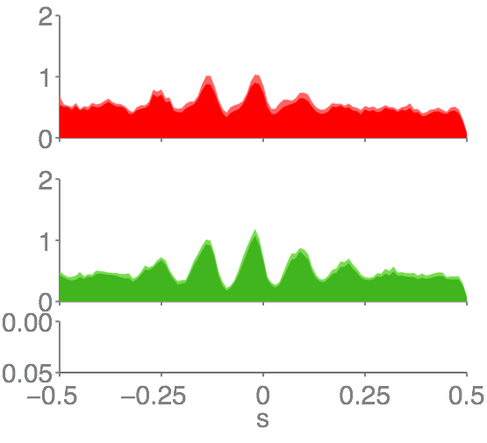
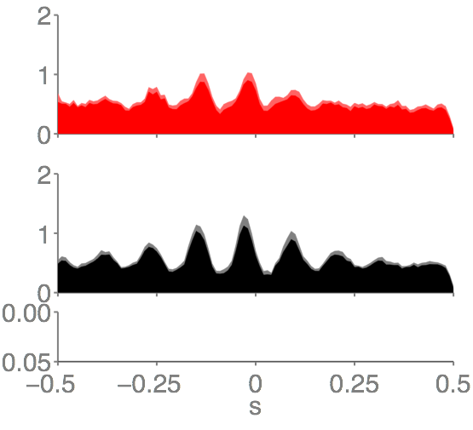
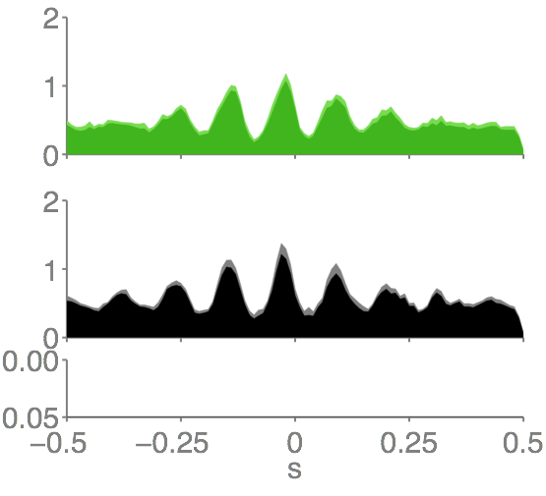
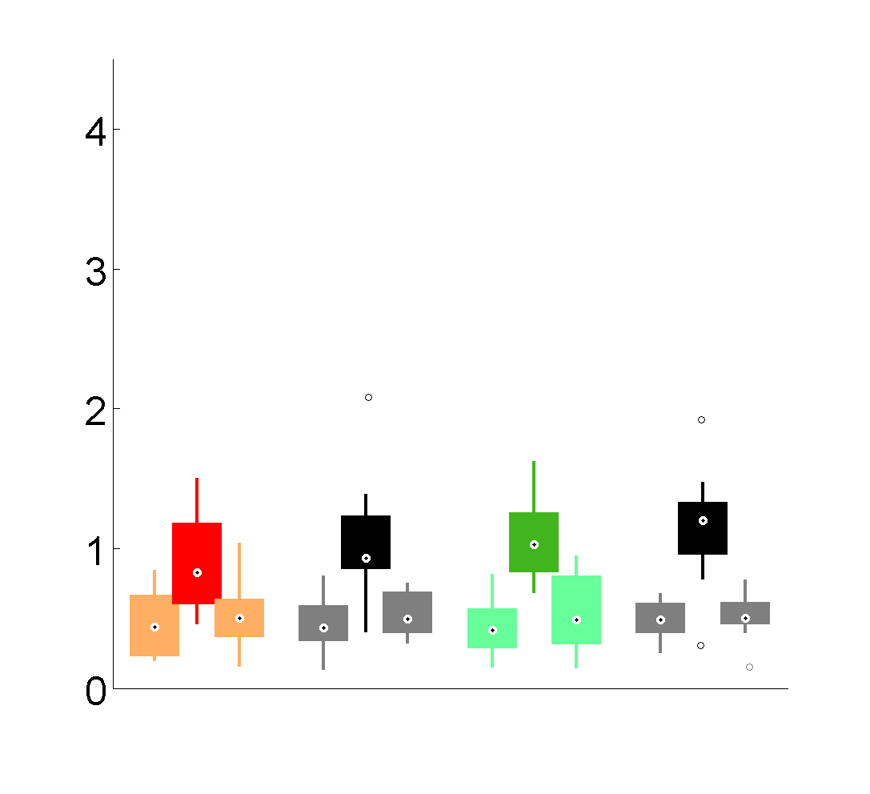

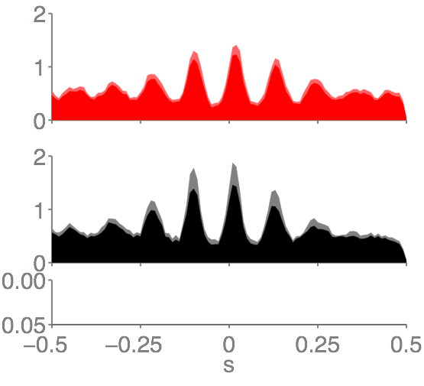
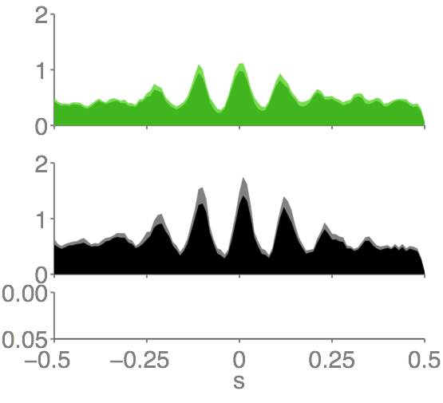
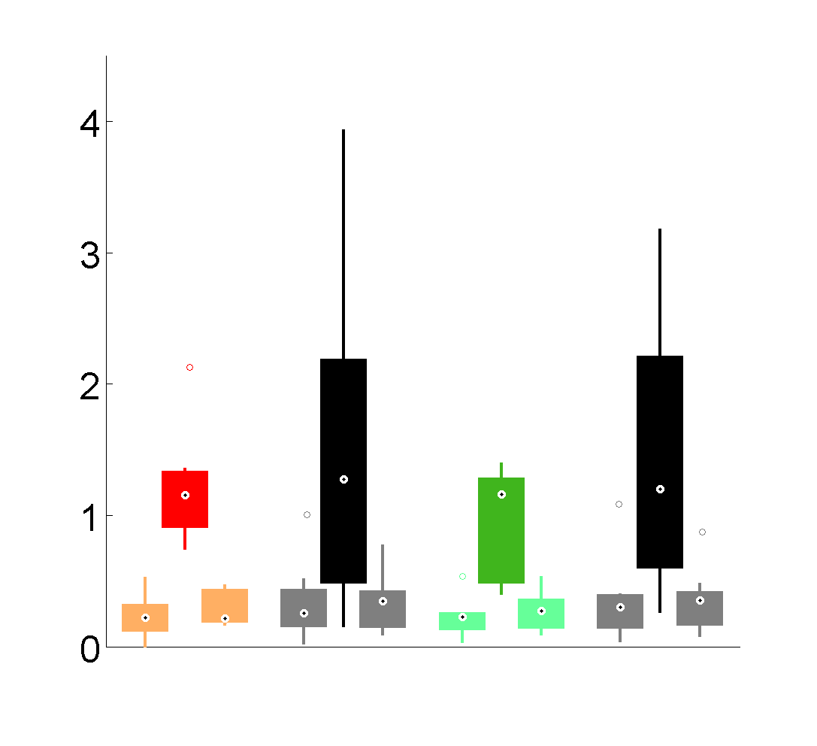
A
B
raw CA1 LFP
filtered CA1 LFP
(100-250 Hz)
IN
OUT
NoSTIM
2 mV
50 ms
2 mV
100 ms
Ripple density at
FRO peaks and troughs
C
Ripple event-correlation with spindles in FRO recordings
D
IN
IN
OUT
Ripple density (%)
FRO
OUT
NoSTIM-IN
NoSTIM-OUT
Ripple density (%)
P
Ripple event-correlation with spindles in PAR recordings
IN
NO-IN
OUT
NO-OUT
Spindles in PAR
IN
IN
OUT
Ripple density (%)
***
***
***
***
PAR
OUT
NoSTIM-IN
NoSTIM-OUT
Ripple density (%)
***
***
**
**
P
IN
NO-IN
OUT
NO-OUT
Ripple event-correlation with spindles in CA1 recordings
Spindles in CA1
IN
IN
OUT
***
***
***
***
Ripple density (%)
**
CA1
OUT
NoSTIM-IN
NoSTIM-OUT
**
Ripple density (%)
***
***
P
IN
NO-IN
OUT
NO-OUT

